Slide 1
South King & Pierce Cooperation

Slide 2
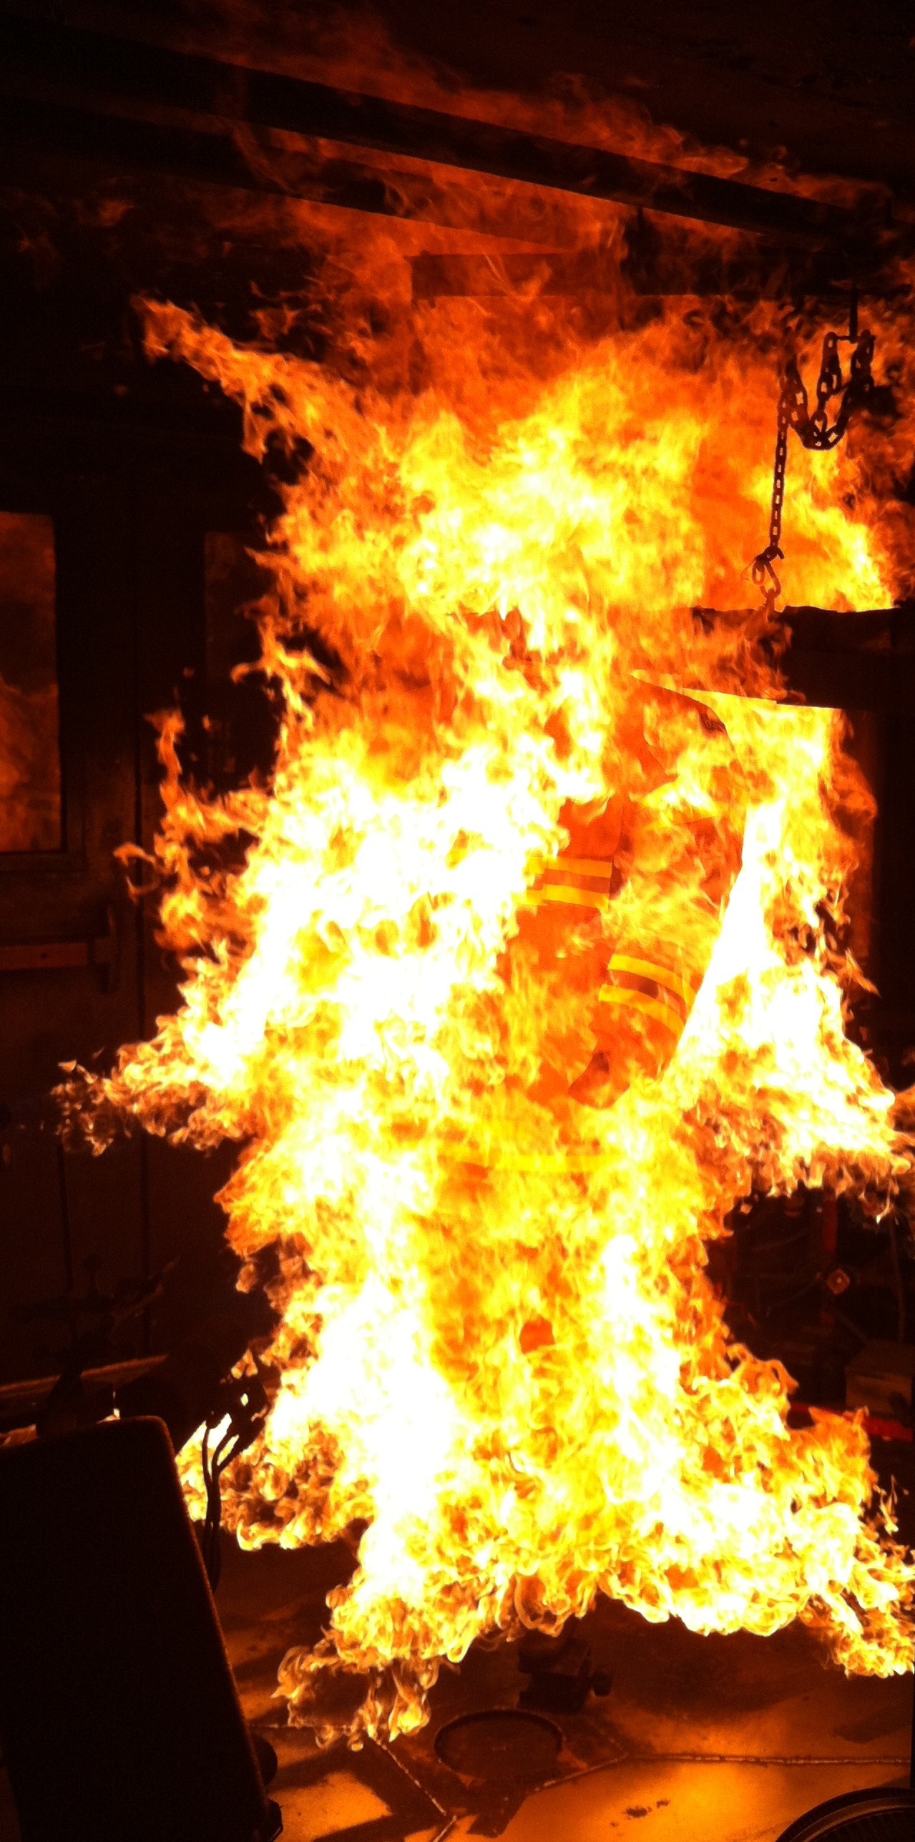
Cooperative Objectives
Comply with standards
WAC 296-800-16005, 10 & 15
WAC 296-305-02001
NFPA 1851
Optimize PPE performance within
budget constraints
Establish an evidence-based standard
Drive reform in turnout manufacturing

Slide 3
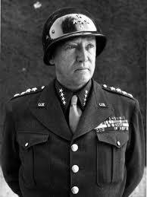
Historical

Slide 4
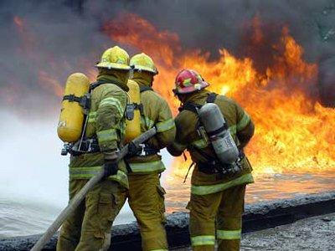
Phase One “User Satisfaction”
Break In
Primary Set
Real incidents/drills
One “month” operations
Secondary Set
Ten specified workouts
74%
Evaluations
20 Dimensions each for coat and pants
Summarized as a percentage of satisfaction

Slide 5
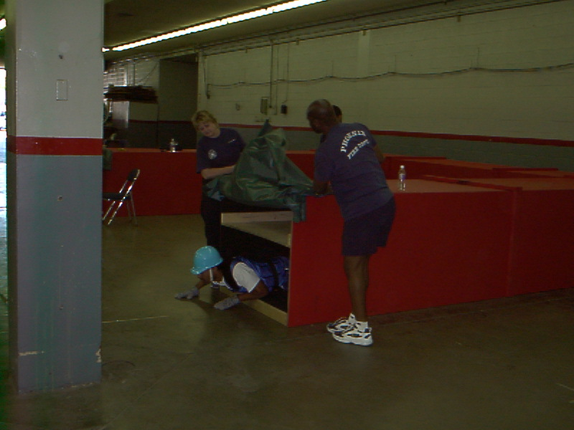
Phase Two “Head to Head”
Six CPAT-based stations executed in all turnouts sequentially
Tailboard step
Stairclimb
Ceiling pull
Crawl
Lift and drag
Ladder manipulation
Choose the highest performing ensemble.

